Slide 1
HUMAN ACTIVITY PATTERNS FROM SMART HOME BIG DATA FOR HEALTHCARE APPLICATONS USING MACHINE LEARNING
UNDER THE GUIDANCE OF:
MR.MIR MUSTAFA ALI,
ASSISTANT PROFESSOR
MRS.TANVEER SULTANA,
ASSISTANT PROFESSOR
DEPARTMENT OF IT
DONE BY:
FARA FATIMA 160318737002
NIDA MARIYAM 160318737006
NABELA FATIMA 160318737011

Slide 2
CONTENTS
Introduction
Objective
Literature Survey
Existing System
Proposed System
Architecture
Advantages
Hardware and Software requirements
Modules
Conclusion
References

Slide 3
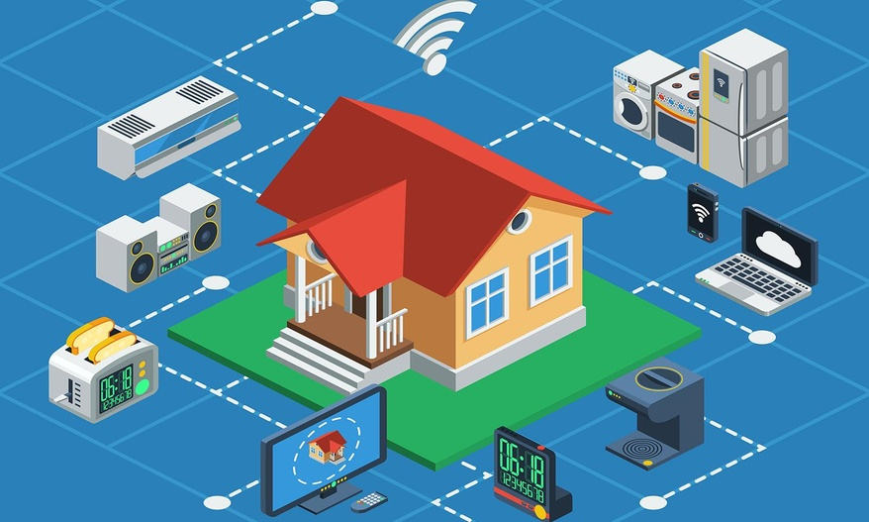

Slide 4
Introduction
Studies show that by year 2050, 66% of the world population will be living in urban areas.
This unprecedented demographic change places enormous burden on cities to rethink the traditional approaches of providing health services to residents.
In such transformation, millions of homes are being equipped with smart devices (e.g. smart meters, sensors etc.) which generate massive volumes of fine-grained and indexical data that can be analyzed to support health care services.

Slide 5
Cont.,
For example, monitoring the changes of appliance usage inside a smart home can be used to indirectly determine the person’s wellbeing based on historical data.

Slide 6
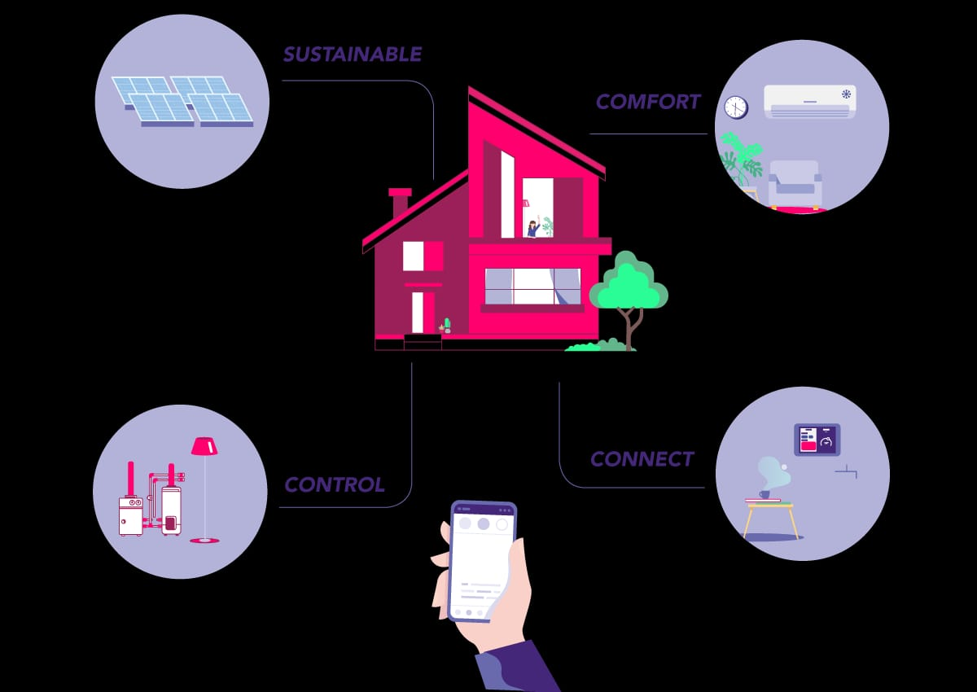

Slide 7
Objective
This project proposes the uses of energy data from smart meters installed at homes to unveil important activities of inhabitants and changes in behavior. Disaggregated power consumption readings are directly related to the activities performed at home.

Slide 8
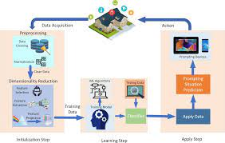

Slide 9
Literature Survey
Author: C. Song et al.,
Title: Modeling the scaling properties of human mobility
While the fat tailed jump size and the waiting time distributions characterizing individual human trajectories strongly suggest the relevance of the continuous time random walk (CTRW) models of human mobility, no one seriously believes that human traces are truly random.
We introduce two principles that govern human trajectories, allowing us to build a statistically self-consistent microscopic model for individual human mobility.

Slide 10
Literature Survey 2
Author: Eunju Kim, Diane Cook, Sumi Helal
Title: Human Activity Recognition and Pattern Discovery
This article focused on recognizing simple human activities. Recognizing complex activities remains a challenging and active area of research and the nature of human activities poses different challenges.
The first focuses on accurate detection of human activities based on a predefined activity model.

Slide 11
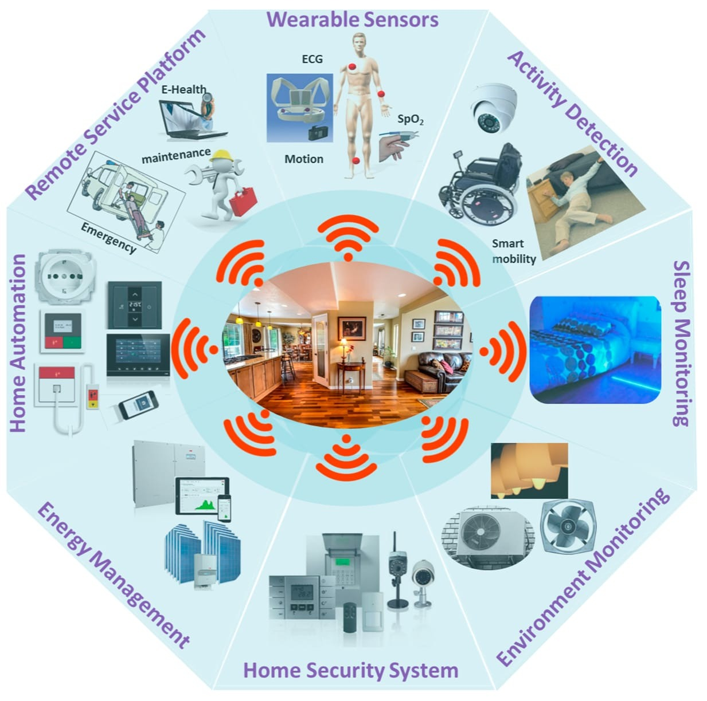

Slide 12
Existing System
Previous works failed to handle long term behaviour changes.
Previous approaches have not considered appliance level usage details.
Operation overlaps has not been considered.
Deriving accurate predictions has been a challenge so far.
Previous models can be used only for short term predictions.
Some of the approaches are found to be good at experimental set up but have not considered real world scenarios.

Slide 13
Limitations of Existing System
Activities daily living (ADL) of users is monitored and the general activity patterns are modelled according to the user position in his/her environment.
Thereby, any anomalous or unexpected behaviour of the activity pattern can be detected.
Moreover, other researches have been employed to mitigate the activity recognition issues with different approaches in various real world activities.
However, the diversity and complexity in activities are often very high in daily living.

Slide 14
Proposed System
HAPP model based on appliance usage variations in smart homes appliance.
This model utilizes FP growth for pattern recognition.
This model applies k-means clustering algorithm to identify appliance-appliance and appliance-time associations. This is achieved by Incremental mining.
Different ML algorithm has been applied for activity prediction based on individual and multiple appliance usage.
For added accuracy, the HAPP model integrates both appliance-appliance and appliance-time associations.

Slide 15
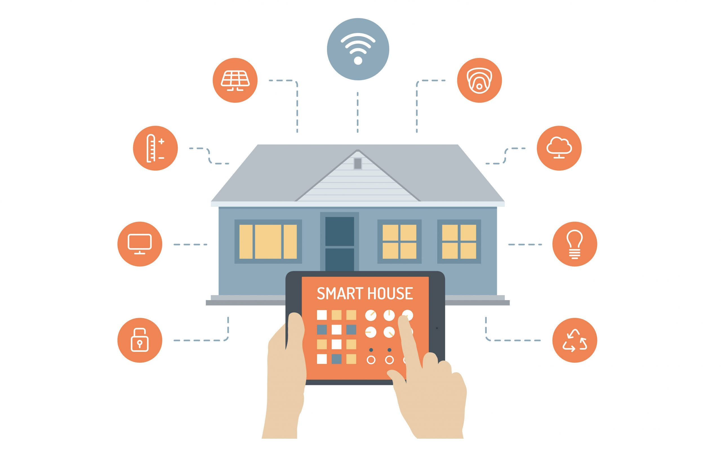

Slide 16
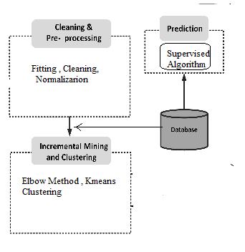
Architecture

Slide 17
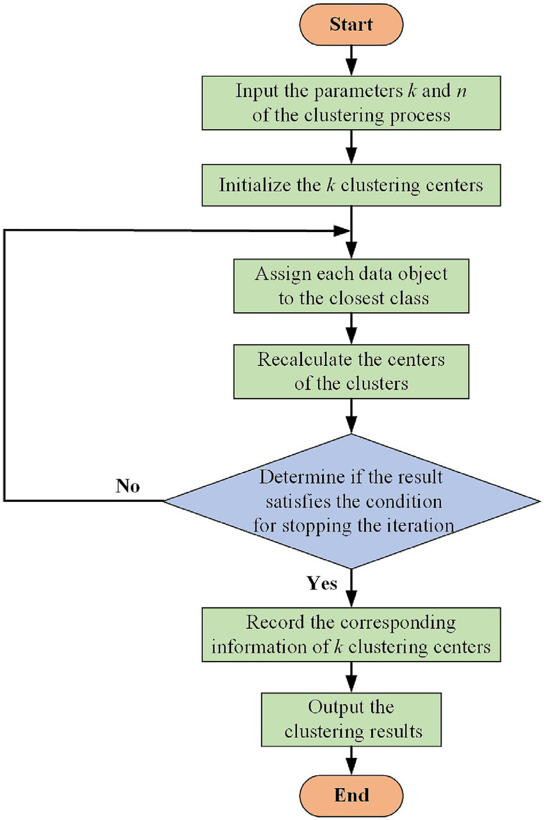

Slide 18
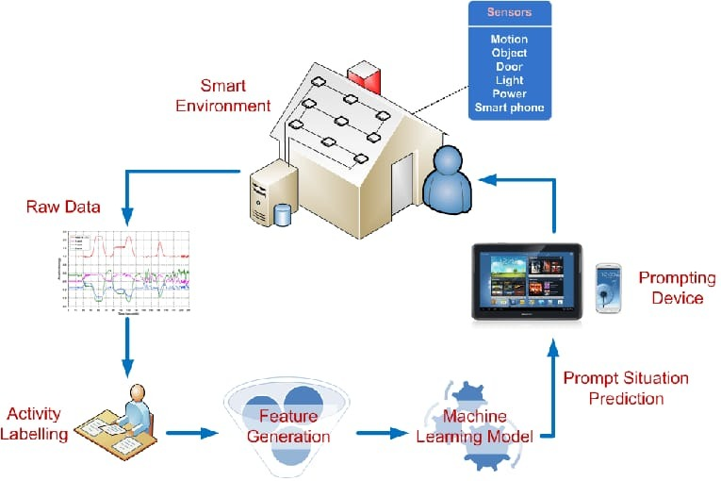

Slide 19
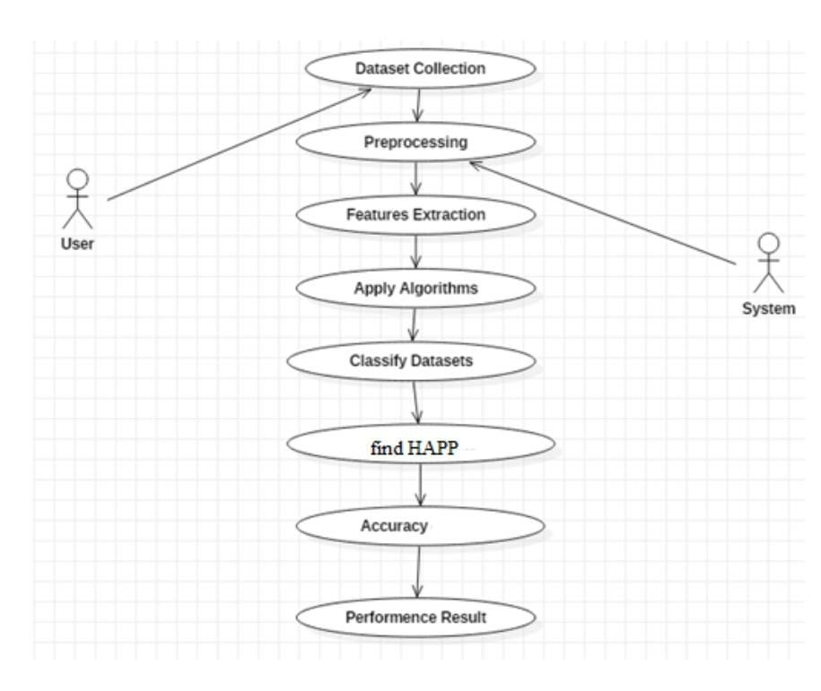
uml diagrams
use case diagram

Slide 20
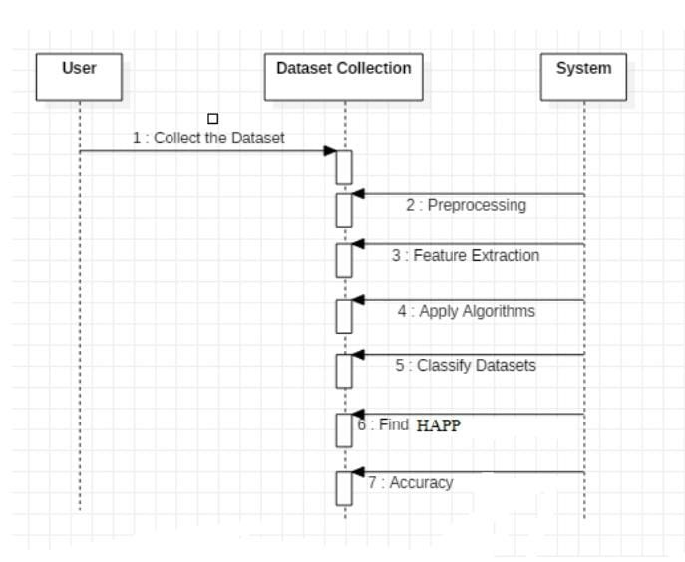
Sequential Diagram

Slide 21
Advantages
It was demonstrated that the FP-growth is as successful as other techniques, such as the Eclat method and the Decision tree algorithm.
Therefore, the FP-growth is given as input to the K-pattern clustering and its efficiency contributes widely to the identification of frequent activity patterns of user behavior in the smart home environment.
The last stage is to group similar patterns by using the frequent activity patterns’ mining.

Slide 22
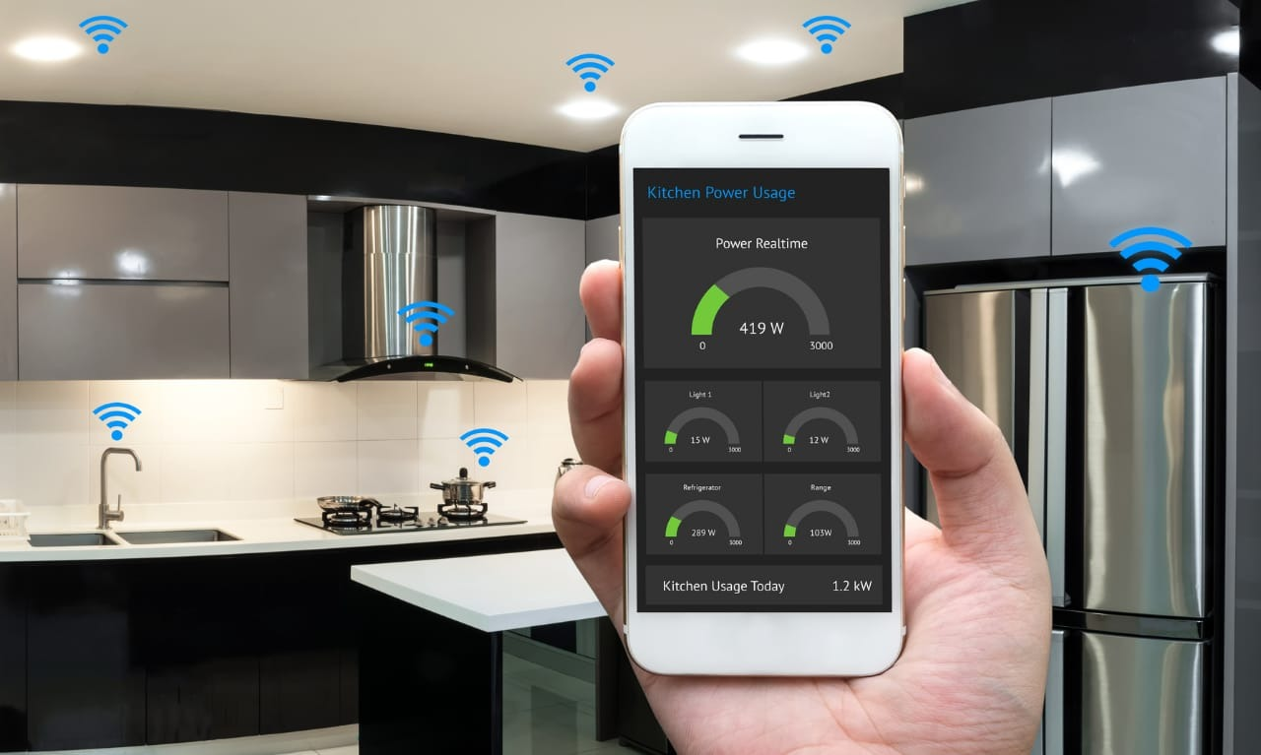

Slide 23
Hardware and Software Requirements
Hardware:
OS – Windows 7,8 or 10 (32 or 64 bit)
RAM – 4GB
Software:
Python IDLE
Anaconda – Jupiter Notebook

Slide 24
MODULE
Data Preparation
Extracting Frequent Patterns of Human Activities
Clustering Analysis: incremental k-means
Model Selection

Slide 25
Data Preparation
The dataset used in this study is a collection of smart meters’ data from five houses in the United Kingdom (UK).
This dataset includes 400 million raw records at time resolution of 6 seconds.
Smart meters time-series raw data, which is a high time-resolution data is transformed into a 1-minute resolution load data subsequently translated into a 30 minutes time-resolution source data, i.e. 24 * 2 = 48 readings per day per appliance

Slide 26
Extracting Frequent Patterns of Human Activities
As mentioned earlier, the aim is to discover human activity patterns from smart meters’ data. For example, activities such as” Watching TV, Cooking, Using Computer, Preparing Food and Cleaning Dishes or Clothes” are usually regular routines.
Our aim is to detect the patterns of these activities so that a health care application, that monitors sudden changes in patient’s behavior (e.g. patients with cognitive impairment), can send timely alert to health care providers.
which propose pattern growth or FP-growth approach using depth-first divide-and-conquer technique.

Slide 27
Clustering Analysis: incremental k-means
Discovering appliance-to-time associations is vital to health applications that monitor patients’ activity patterns on a daily basis.
A clustering analysis mechanism is used to discover appliance usage
Appliance-to-time associations are underlying information in the smart meter time series data which include sufficiently close time-stamps, when relevant appliance has been recorded as active or operational.
Using this data we can group a class or cluster of appliances that are in operation simultaneously or overlapping.

Slide 28
Model Selection
To avoid over fitting, both methods use a test set (not seen by the model) to evaluate model performance. Performance of each classification model is estimated base on its averaged. The result will be in the visualized form. Representation of classified data in the form of graphs.
We have used RF Regressor, DTree Regressor ,SVM Regressor for predicting accuracy score
Accuracy is defined as the percentage of correct predictions for the test data. It can be calculated easily by dividing the number of correct predictions by the number of total predictions.

Slide 29
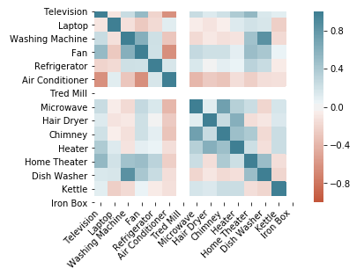
Result: Correlation Graph

Slide 30
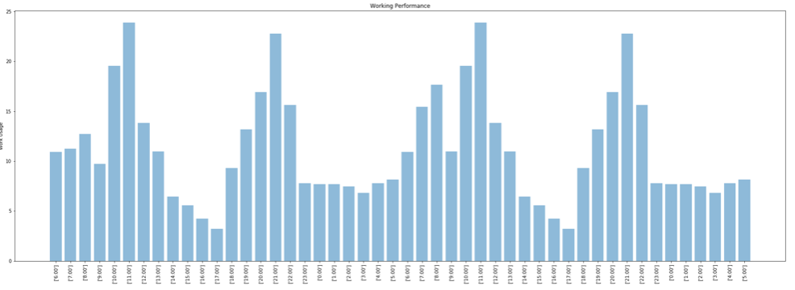
Bar Graph of Home Appliance Usage

Slide 31
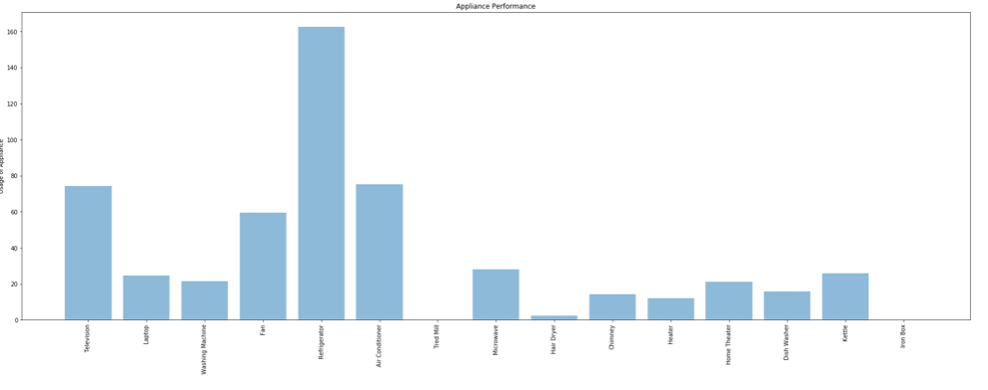
Bar Graph of Home Appliance Usage

Slide 32
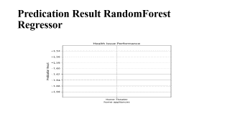
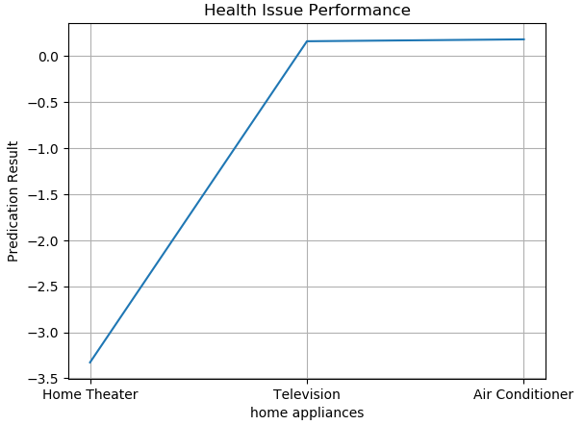
Predication Result DecisionTree Regressor

Slide 33
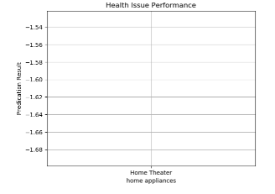
Predication Result RandomForest Regressor

Slide 34
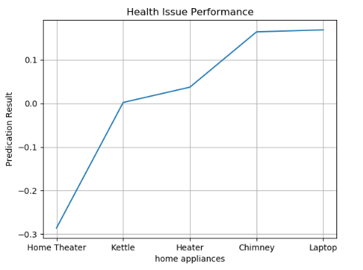
Predication Result SVM Regressor

Slide 35
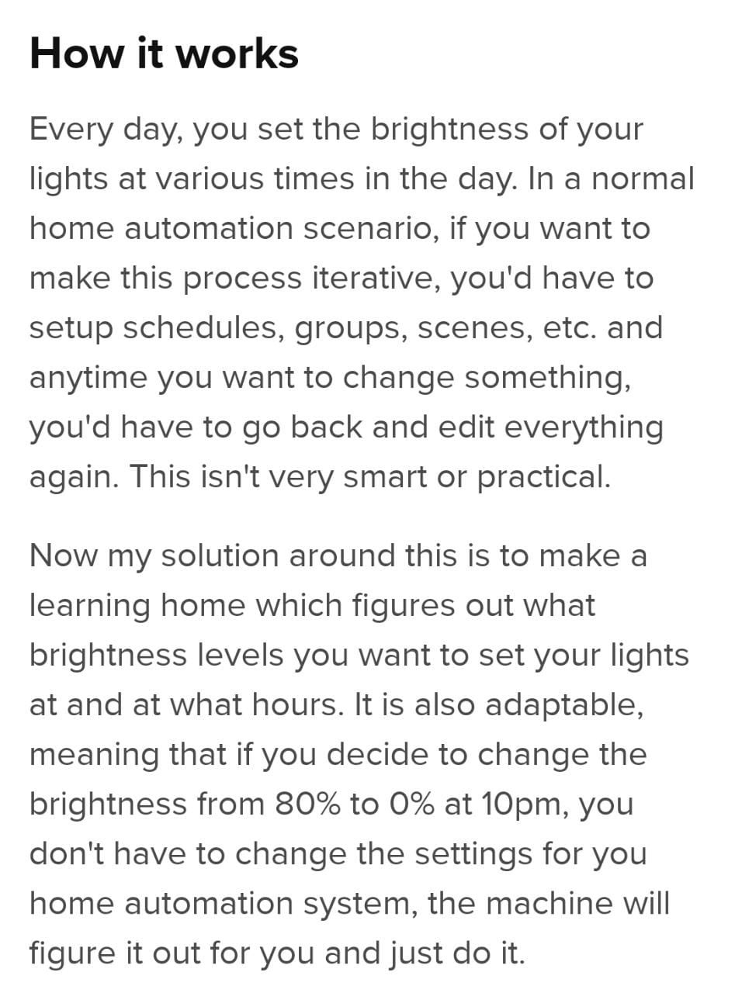
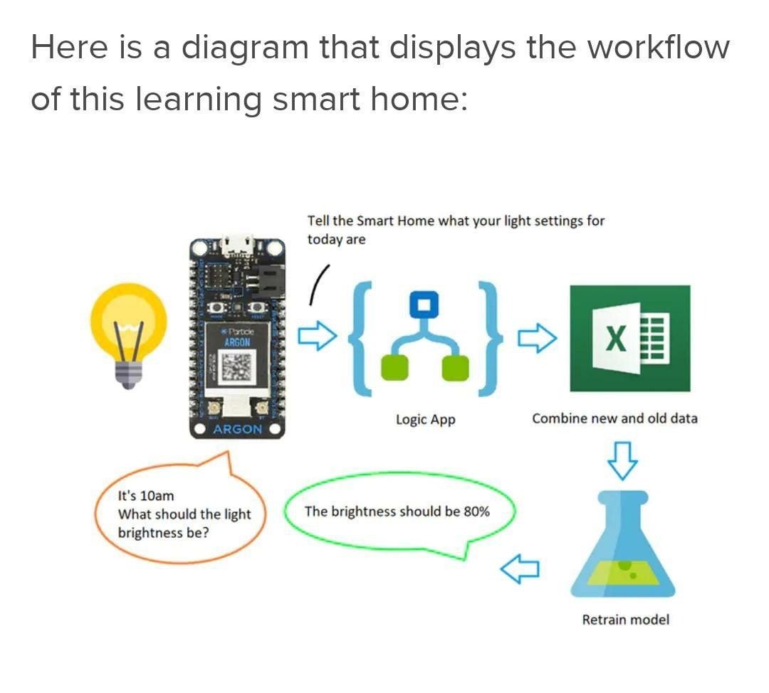

Slide 36
Conclusion
From the experiment results we have demonstrated the applicability of the proposed model to correctly detect multiple appliance usage and make short and long term prediction at high accuracy result and Addiction.

Slide 37
Future Work
For future work, we can plan to refine the mode land introduce distributed learning of big data mining from multiple houses in a near real-time manner. This will help health applications to promptly take actions such as sending alert to patients or care providers. Furthermore, we can plan to build a health ontology model to automatically map discovered appliances to potential activities. This means we can efficiently train the system and increase the accuracy of detecting human activities.

Slide 38
Reference
[1]N. United, “World urbanization prospect.” United Nation, 2014. [Online]. Available: http://dl.acm.org/citation.cfm?id=308574. 308676
[2] M. S. Hossain, “Cloud-supported cyber-physical localization framework for patients monitoring,” IEEE Systems Journal, vol. 11, no. 1, pp. 118–127, March 2017.

Slide 39
Cont.,
[3] M. S. Hossain, G. Muhammad, W. Abdul, B. Song, and B. Gupta, “Cloud-assisted secure video transmission and sharing framework for smart cities,” Elsevier, Future Generation Computer Systems Journal, April 2017.
[4] J. Liao, L. Stankovic, and V. Stankovic, “Detecting household activity patterns from smart meter data,” in Intelligent Environments (IE), 2014 International Conference on, 6 2014, pp. 71–78.

